Slide 1






S&P 500 Value Investing Recommendations
By Miguel Santos
Project Overview
Insights & Recommendations
Data Collection
Data Cleaning
Data Analysis

Slide 2






Project Overview
Project Title: S&P 500 Value Investing Recommendations
Objective: The objective of this project is to identify which sectors and stocks from the S&P500 are overvalued and which ones may be the best value. This model’s output is valuable to quickly find possible value or overpriced stocks, but it is important to explore specific company level factors before providing the final Recommendation that the model could not capture (eg.: Mergers & Acquisitions, Industry trends, Management’s quality, guidance and strategy, Risk Factors (Legal, Regulatory, Political, Currency), among others.
Scope: The stock prices were extracted during the session of 24-10-2025.
Tools used: This project was made using Google Sheets and Power BI.
Methodology: The process involved cleaning the data and logging any identified issues, followed by detecting and treating outliers to ensure data reliability. Additional metrics and measures were then created to enhance the analytical depth of the dataset. All metrics used to Score the companies were normalized to a common [0–1] scale, enabling consistent comparison across different indicators. Before creating the Rating, a composite Score was calculated using a weighted average of the most important metrics, reflecting their relative significance. Finally, interactive and intuitive dashboards were developed in Power BI to visualize the results and facilitate the exploration and extraction of relevant information from the data.

Slide 3
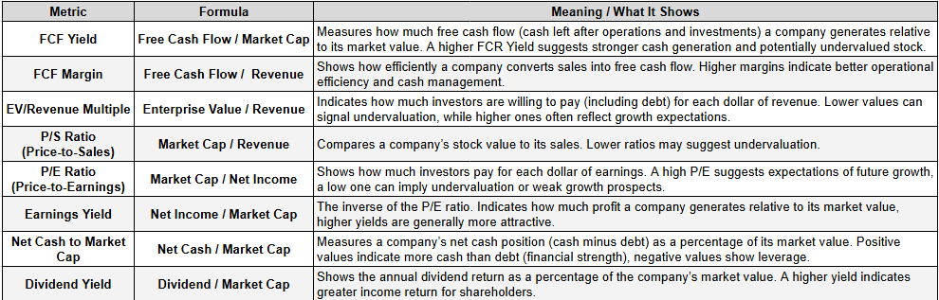
Project Overview
Ratios Glossary

Slide 4
Project Overview
Executive Summary
Risk Reduction and Value Rotation:
This current market environment indicates a clear rotation out of overvalued positions, into sectors offering superior value and income stability. The primary action is a shift away from the Technology sector and towards Energy. The Technology sector is currently priced for very optimistic scenarios, fueled by the Artificial Intelligence (AI) boom, resulting in extreme multiples like a 9.55 EV/Revenue Multiple and a 52.06 P/E Ratio. This aggressive valuation, resulting in only 38% "Buy or Hold" ratings, exposes severe downside risk. Consequently, the core SELL action focuses on reducing exposure to overvalued stocks like Tesla (TSLA), Palantir (PLTR), and Datadog (DDOG), alongside fundamentally weak plays such as Intel (INTC) and Fidelity National Information Services (FIS), which are struggling with negative FCF and high leverage, respectively.
The capital generated from these sales should be strategically reallocated into two categories: deep-value income plays and the underpriced Energy sector. Defensive income investments include high-quality, undervalued companies like Pfizer (PFE) and United Parcel Service (UPS), which both offer exceptional dividend yields near 7%. This provides critical downside protection and reliable cash flow.
The second, more growth-oriented allocation targets the Energy sector, which presents a compelling value proposition. Energy stands as the cheapest sector, trading at a moderate EV/Revenue multiple of 3.87, yet matches Technology with a leading 13% Revenue Growth. This opportunity is underpinned by the essential need for vast, reliable power required to run the expensive AI infrastructure. Key Energy buys like ONEOK (OKE) and Diamondback Energy (FANG), offering strong growth and dividend yields around 6%, allow the portfolio to capitalize on the foundational requirements of the current innovation cycle while maintaining low valuation risk.

Slide 5
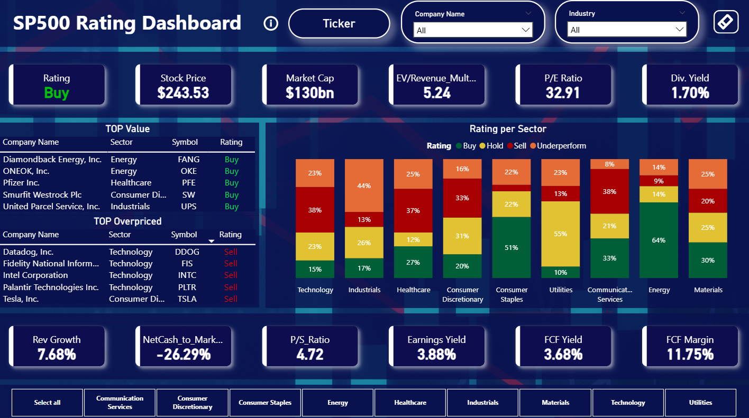
Project Overview

Slide 6
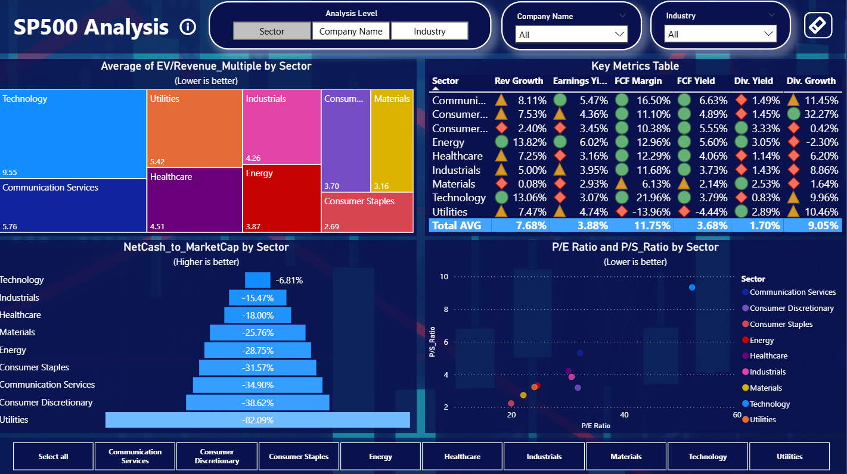
Project Overview

Slide 7
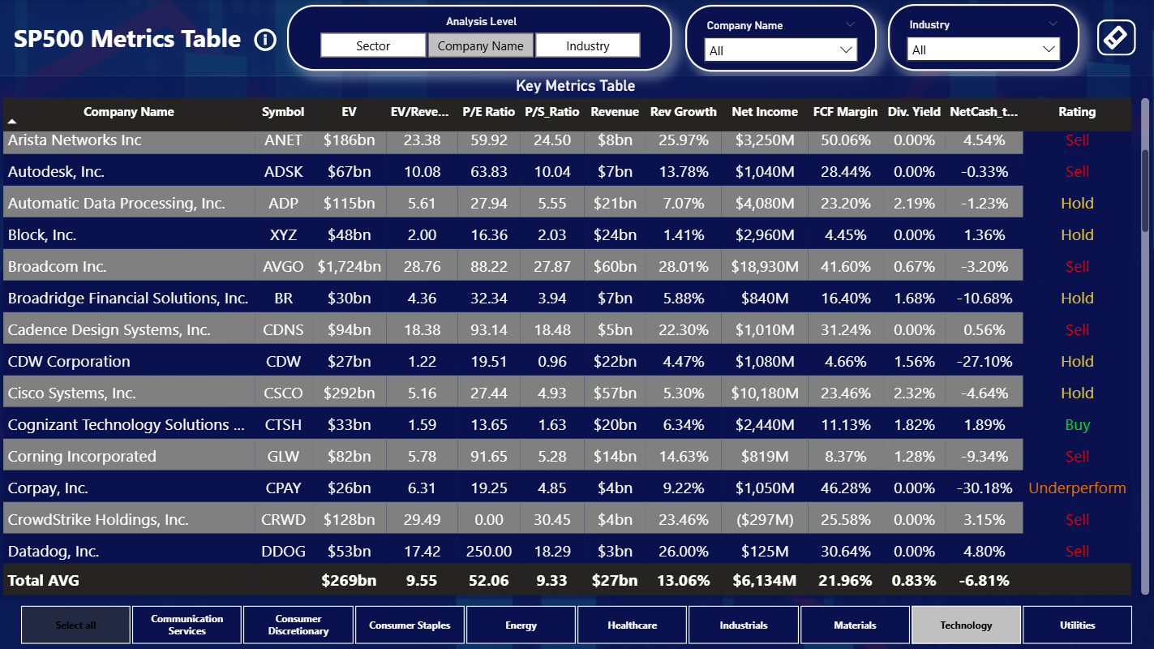
Project Overview

Slide 8
Insights
Sector based insights
Energy and Consumer Staples have the highest percentage of "Buy or Hold" ratings, at 78% and 73% respectively.
Technology and Healthcare have the lowest percentage of "Buy or Hold" ratings, at 38% and 39% respectively.
Despite having very strong fundamentals, with 13% Revenue Growth and very low leverage (-6.81% NetCash to Market Cap), Technology stands out as very expensive, with a 9.55 EV/Revenue Multiple, 52.06 P/E Ratio and a 9.33 P/S Ratio, reflecting very strong growth optimism despite low revenue for its current price.
Energy stands out as the cheapest sector, with a low EV/Revenue multiple of 3.87. Its fundamentals are robust, leading the S&P 500 in Revenue Growth (+13%) alongside Technology, while also showing strong performance across Earnings, Free Cash Flow (FCF), and Dividend metrics. This combination of favorable valuation and strong growth, suggests that the Energy sector offers significant potential for value-oriented investors.

Slide 9
Insights
TOP 5 Value Companies
Contrary to the TOP 5 Overvalued, which belong basically to the Technology sector, the best companies identified by the model come from 3 different sectors, with Energy being the only one to output 2 companies, while others only 1 each.
Pfizer Inc. (PFE): Trades at a discount by most valuation metrics (EV/Revenue Multiple of 2.97 vs 4.51, P/E Ratio of 13.10 vs 30.16, 2.21 P/S Ratio vs 4.21) and outperforms on many, like Revenue Growth (13.53% vs 7.25%), FCF Margin (13.49% vs 12.29%) has $64bn in Revenue compared to $58bn from sector average and yet has 3x the Net Income. It also has a very attractive 7% Dividend Yield, the biggest drawback is it’s high leverage, with 35% Net Cash to Market Cap.
United Parcel Service (UPS): Trades at a very good discount relative to the Industrials sector, with a P/E of 13.0 versus the sector's 30.7. While it exhibits conservative revenue growth (0.9%) and lower cash efficiency (3.9% FCF margin) compared to peers, its appeal is driven by an exceptional 7.48% dividend yield, generated by its very generous $5.7bn of Net Income.
ONEOK, Inc. (OKE): Appears financially solid and is trading at a good discount compared to its peers (2.71 EV/Revenue Multiple vs 3.87 sector wise, 14 P/E vs 24.63), with very solid revenue growth (46.4%) and a robust 5.98% dividend yield. Leverage is high relative to its Market Cap (74.50%), but the cheap price and solid financial performance makes up for that.
Diamondback Energy (FANG): an energy infrastructure company, appears undervalued compared to industry averages (EV/Revenue: 2.71 vs. 3.87; P/E: 14.1 vs. 24.63). It boasts strong revenue growth (46.4%) and a healthy $3.1B net income. The company demonstrates efficient cash generation with a 10.3% free cash flow margin. Overall, OKE is a compelling, growing, mid-to-high-yield play offering a robust 5.98% dividend yield.
Smurfit Westrock Plc (SW): Trades at a very modest EV/Revenue multiple of 1.17 and 0.73 P/S Ratio compared to 3.19 sector wise. Despite exceptional 162% revenue growth, its P/E ratio of 63.8 indicates that earnings remain thin. Leverage is high for its Market Cap but the generous 4% Dividend Yield and the very low valuation makes up for the negatives.

Slide 10
Insights
TOP 5 Overvalued Companies
All of the top 5 overvalued companies belong to the Technology sector, except for Tesla, which could very easily be categorized similarly with the AI and Robotics investments. This suggests a potential bubble might be brewing in the sector.
Tesla, Inc. (TSLA): Trades at extraordinarily high valuation levels (P/S and EV/Revenue are roughly 4× higher than the Consumer Discretionary sector average) and has a 250 P/E Ratio, reflecting high expectations, despite a recent revenue decline of 1.6%.
Palantir Technologies Inc. (PLTR): Trades at extreme multiples (EV/Revenue 125.5 and P/S 127.2) that far exceed sector norms, though this is supported by impressive revenue growth (38.8%) and a very strong cash flow margin (49.7%). Despite strong fundamentals, its valuation is way too high.
Datadog, Inc. (DDOG): Commands a premium valuation (double the sector average EV/Revenue Multiple and P/S Ratio, which is already the most expensive sector to begin with), supported by impressive revenue growth (26%) and a robust free cash flow margin (30.6%). Despite strong fundamentals, the price is too high.
Intel Corporation (INTC): Has low multiples compared sector-average but shows weaker operational fundamentals, including a revenue decline (-1.5%) and significant cash burn (FCF margin of -15.8%). Mainly due to the operational struggles to find a path to significant profitability, plus the modest leverage above sector average makes the company too risky to invest.
Fidelity National Information Services (FIS): Trades at a discount on EV/Revenue and Sales multiples, but its Net Income and Revenue Growth are significantly below sector averages, and it carries high leverage.

Slide 11
Recommendations
Sector Rotation: Sell Technology, Buy Energy.
The sector analysis highlights a dramatic valuation gap and a potential rotation opportunity driven by the current innovation cycle. The Technology sector, despite possessing strong underlying fundamentals like a leading 13% Revenue Growth and low leverage, is priced at extreme multiples, including a 9.55 EV/Revenue Multiple and a lofty 52.06 P/E Ratio.
This premium is largely fueled by optimism surrounding the Artificial Intelligence (AI) boom, which embeds expectations for years of exponential growth. This high conviction, however, stands in sharp contrast to our models output of 38% "Buy or Hold" ratings for Tech companies. Suggesting a high-multiple environment where the sector is extremely susceptible to sharp corrections if AI-driven growth forecasts are even slightly missed.
Conversely, the Energy sector stands out as a highly sensible, value-oriented play on the Tech-driven future. While Energy is currently the cheapest sector, trading at a moderate EV/Revenue multiple of 3.87, its fundamentals are robust, matching Technology with 13% Revenue Growth while also enjoying the highest "Buy or Hold" ratings at 78%.
The key link lies in the simple fact that the computational infrastructure driving the multi-trillion-dollar AI boom, from data centers to next-generation chip manufacturing requires vast, reliable power. Investing in the undervalued Energy sector, which provides the essential fuel for the expensive Technology sector to operate, offers a high-conviction value opportunity that capitalizes on the foundational needs of the current growth cycle.

Slide 12
Recommendations
Buy recommendations:
The primary buy recommendations are centered on high-quality companies trading at steep discounts and offering superior income. Investors should target deep value by purchasing Pfizer (PFE) and United Parcel Service (UPS), both of which are significantly undervalued relative to their sectors (P/E ratios around 13.0) and offer exceptional dividend yields of 7% and 7.48%, positioning them as strong income and defensive plays.
Within the cheap Energy sector, the model favors ONEOK (OKE) and Diamondback Energy (FANG) for their undervaluation, solid growth (especially OKE's 46.4% Revenue Growth), and strong dividend payouts (around 6%), while Smurfit Westrock (SW) is noted as deep value buy due to a very low sales and EV/Revenue multiple while having exceptional revenue growth (162.45%)
Sell recommendations:
The sell recommendations focus on reducing exposure to overvalued stocks, particularly within the Technology sector. These are issued for the heavily overvalued stocks like Tesla (TSLA), Palantir (PLTR), and Datadog (DDOG), as their current extreme multiples (250 P/E) are unsustainable and priced for very optimistic scenarios. Additionally, it is recommended to sell risky stocks like Intel (INTC), due to its negative FCF margin and operational struggles, and Fidelity National Information Services (FIS), due to its combination of low growth, very weak net income, and high leverage within a sector that tends to score very well in those metrics.

Slide 13
Data Collection
Dataset: https://github.com/zmsantos08/S&P500_Value_Investing_Recommendations/blob/abcdde92088df1c3b6888556e4d36cbaf46ebaa3/S&P500_Project.xlsx
About the dataset: This dataset contains real world information covering many metrics from S&P 500 companies across 4 different tables (S&P500_overview, S&P500_performance, S&P500_Price, S&P500_Dividends). It was extracted on 24-10-2025 from https://stockanalysis.com/list/sp-500-stocks/ and it covers 503 companies. After the removal of GOOG, Financials & Real Estate we are left with 402 companies. These are the metrics extracted originally, before we added more valuable metrics with the information provided.
Sector - The broadest category of business (e.g., Technology, Healthcare, Utilities, Energy, etc). Industry - The specific group of businesses within a Sector (e.g., Semiconductors, Drug Manufacturers, Restaurants, etc). Company Name - The official name of the corporation. Symbol - The unique ticker code used for trading the stock (e.g., AAPL). Market Cap - The total value of a company's outstanding shares (Share Price $\times$ Shares Outstanding). Stock Price - The current price per share of the company's stock. Revenue - The total income generated from sales of goods/services. Net Income - The company's profit after all expenses, taxes, and interest are deducted. Rev Growth - The percentage change in Revenue compared to a prior period. Net Cash - A company's cash minus its total debt. FCF - Free Cash Flow: Cash from operations minus capital expenditures. Volume - The number of shares traded during a specific period.

Slide 14
Data Cleaning
Financials & Real Estate were deleted from the model, since the metrics available in the dataset are not enough to accurately describe the financial health of companies in those sectors.
Therefore they are also not reliable enough to issue a confident rating on its stock price.
For the Real Estate Sector, it is not possible to calculate:
• FFO = Net Income + Real Estate Depreciation & Amortization - Gains or Losses on Sales of Property
• NAV = Market Value of Properties - Liabilities
• Cap Rate = Net Operating Income / Current Market Value of Properties
• LTV = Total Debt / Total Asset Value
For the Financial Sector, it is not possible to calculate:
• P/B = Market Cap / Book Value
• ROE = Shareholders Equity / Net Income
• NIM = (Interest Revenue - Interest Expense) / AVG Earning Assets

Slide 15
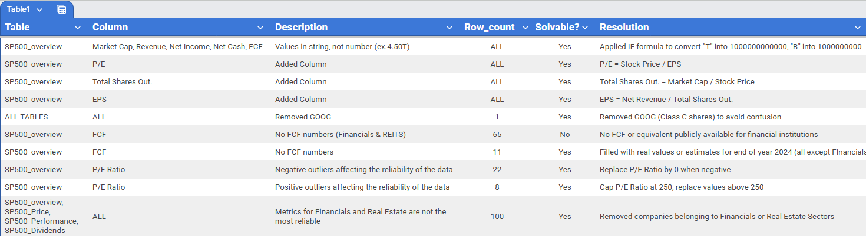
Data Cleaning
Steps taken for Data Cleaning in Google Sheets
General Cleaning;
Added metrics;
Removed Rows;
Replaced Outliers;

Slide 16
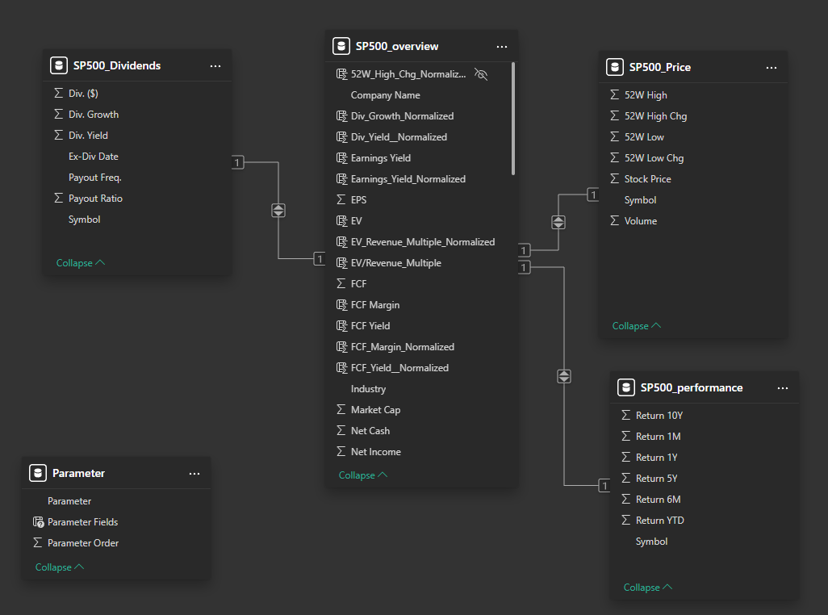
Data Cleaning
The data model is organized into four main tables, focused on different aspects of S&P 500 companies, all linked together using relationships 1-to-1 over the “Symbol” column.
The S&P500_overview table is the central table. It contains a set of financial metrics and acts as the bridge connecting the other three dimension tables.
The key identifier is the “Symbol” field, only showing once in every table, essentially being the primary key in all tables (or a foreign key in the overview table), enabling the connections.
This ensures that metrics from SP500_price, SP500_performance, and SP500_Dividends can be accurately linked back to the correct company on the SP500_overview table.

Slide 17
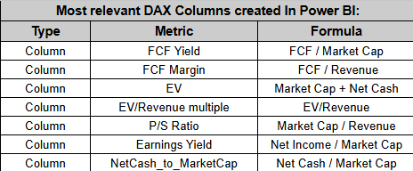
Data Cleaning
Added Metrics and Measures using DAX

Slide 18
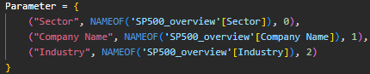

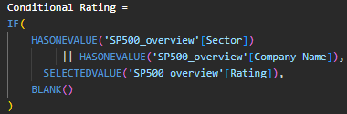
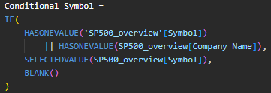
Data Cleaning
Added Metrics and Measures using DAX
Parameter added to create a slicer in order to seamlessly adjust visuals between Sector/Company and Industry level.
Measure added to show the company name on Ticker card or “Ticker” if no company is currently selected.
Measures added to remove the “Total” for the Rating and Symbol column for the “Key Metrics Table” on the SP500_Metrics_Table.

Slide 19
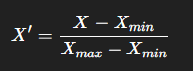
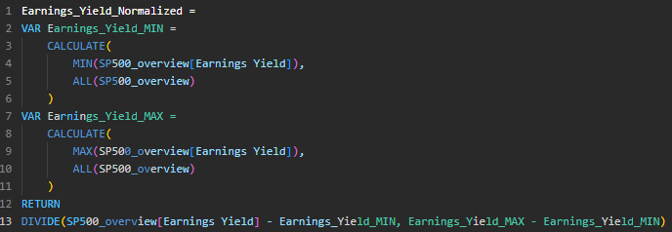
Data Cleaning
Standardization of Metrics
In order to calculate the score and rank companies, we standardized all metrics between [0,1] using Power BI DAX tool, the formula is shown on the side.
This is the example used for Earnings_Yield, the rest of the metrics standardization followed a similar process.
Example for Earnings Yield Normalization

Slide 20
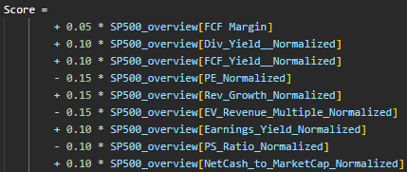
Data Cleaning
Calculating the Score
This DAX measure calculates a composite Score by acting as a weighted-average model that balances a company's Value, Growth, and Quality metrics.
The formula assigns the highest individual weights (15%) to metrics that signal strong momentum, such as rewarding high Rev_Growth while heavily penalizing high valuation multiples like PE and EV_Revenue_Multiple Mid-tier positive weights (10%) are distributed across metrics reinforcing yield and stability, including various yield ratios and NetCash_to_MarketCap, with negative weights consistently applied to valuation multiples to reward relative undervaluation.
This structure ensures that the final score highly favors companies that are fast-growing, cheap relative to earnings and revenue, possess strong cash flow and low leverage, providing a comprehensive measure for the subsequent quartile-based rating system.

Slide 21
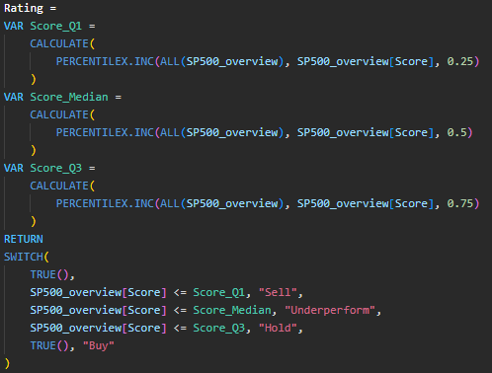
Data Cleaning
Rating the Companies
This DAX measure creates a dynamic, relative rating system by dividing all companies in the SP500_overview table into four performance groups (quartiles) based on their [Score].
The formula first defines three critical, fixed thresholds—the 25th percentile (Q1), the median (50th percentile), and the 75th percentile (Q3)—by calculating the PERCENTILEX.INC of the [Score] column across the entire dataset using the ALL(SP500_overview) filter. This ensures that the thresholds are absolute and consistent, independent of any individual company row.
The rating is then assigned using a SWITCH(TRUE()) statement, which compares a company's individual [Score] against these thresholds: the bottom 25% of scores (Score <= Q1) receive a "Sell" rating; the next 25% (Score <= Median) are rated "Underperform"; the third 25% (Score <= Q3) get a "Hold" rating; and finally, the top 25% of companies (Score >= Q3) are assigned the most favorable "Buy" rating, effectively segmenting the entire SP500 universe into four balanced rating tiers.

Slide 22
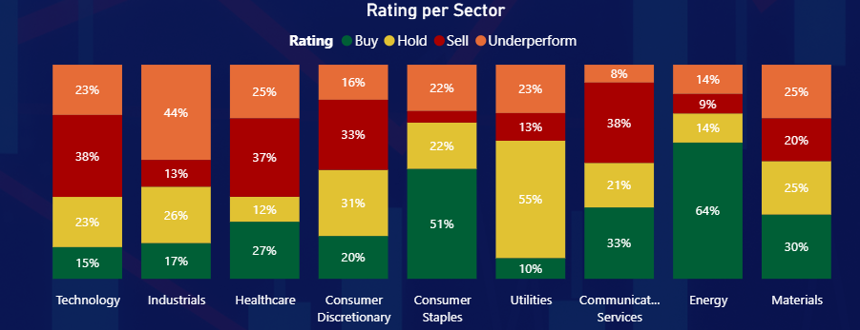
Sectors Analysis
Energy and Consumer Staples have the highest ratings, with 78% and 73% of Buy or Hold respectively. On the other hand, sectors like Technology or Healthcare have the lowest ratings, with a 38% and 39% of Buy or Hold respectively.
All sectors have at least 50% of Buy or Hold ratings, except for Technology, Industrials and Healthcare, although Industrials only has 13% of “Sell” rating, the biggest number is on “Underperform” (with 44%, total of 33).

Slide 23
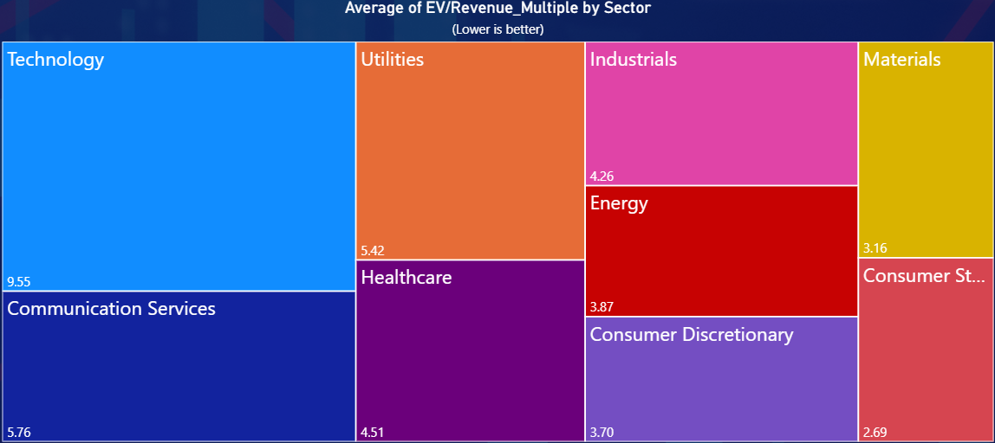
Sectors Analysis
Technology stands out as the most expensive (9.55 multiple), highlighting the low Revenue of the sector for its current price, but reflecting strong growth optimism.
Consumer Staples (2.69), Materials (3.16), and Energy (3.87) sectors are the cheapest, signaling potential value opportunities if markets rotate toward cyclicals or defensive names.

Slide 24
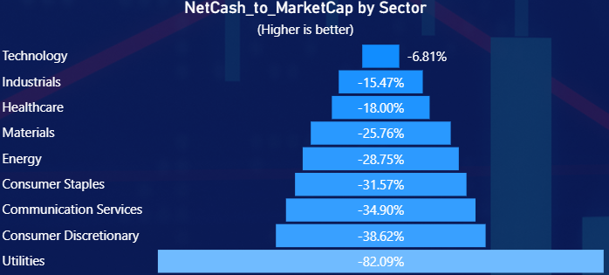
Sectors Analysis
Technology has the lowest Net Cash to Market Cap ratio, with only -6.81%, highlighting that it does deserve a premium for not needing to fund its growth through debt.
Utilities have the highest ratio by far (82.09%), confirming their reliance on debt to fund infrastructure and steady dividends.
Consumer sectors (Staples & Discretionary) show moderate-to-high leverage, 34.90% and 38.62% Net Cash to market Cap respectively.
Energy and Materials have moderate ratios (28.75% and 25.75%) but still below average despite having cyclical earnings.

Slide 25
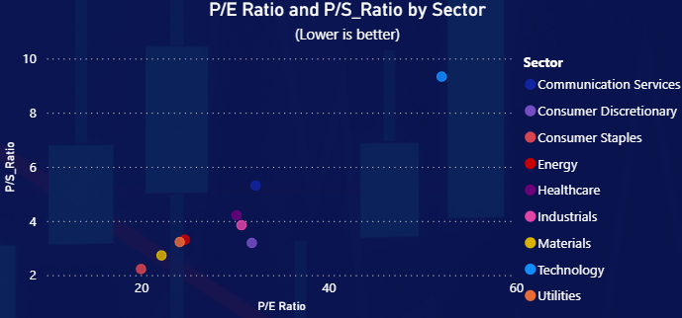
Sectors Analysis
The Technology sector is very expensive compared to all others, given its current Price, Sales and Earnings, with a 52.06 P/E Ratio and a 9.33 P/S Ratio.
Consumer Staples and Materials are the cheapest sectors based on Earnings and Sales, with a 19.97 and 22.16 P/E Ratio respectively and a P/S Ratio lower than 3 in both cases.
Energy and Utilities appear undervalued compared to others, offering potential value plays if earnings hold.
Healthcare, Industrials, Consumer Discretionary and Communication Services occupy a middle ground, with Communication Services being the most expensive of the group with a 32.19 P/E Ratio and 5.31 P/S Ratio.

Slide 26
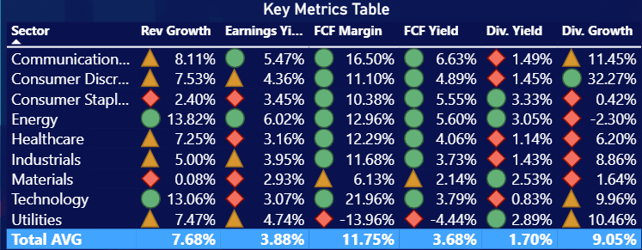
Sectors Analysis
Based on these metrics that capture Revenue, Earnings, FCF and Dividend, Energy is the sector that seems the most attractive, with every metric, except Div. Growth on the top third.
Technology and Energy sector top Revenue Growth, with double digit (+13%), Materials and Consumer Staples were the most stagnant, with 0.08% and 2.40% respectively, way below S&P 500 average (7.68%).
All sectors have FCF Margins with double digits, except for Utilities and Materials, with Utilities being -13.96%, showing some trouble converting Revenue into Cash. Consumer Staples & Discretionary, Energy, Materials and Utilities all have Div. Yields close to 3%, but the biggest jump came from Discretionary, with a 32.27% Div. Growth. Energy was the only sector with a slight 2.30% decrease in Dividend Yield.

Slide 27
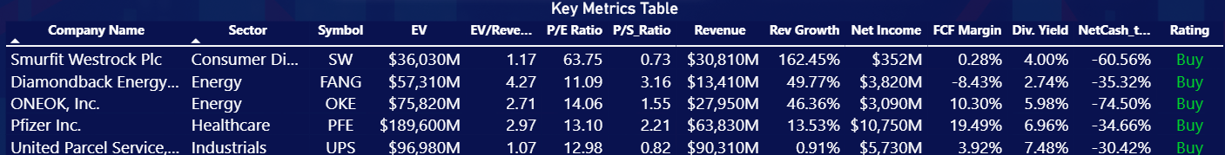





TOP Value
S&P500
These are the TOP 5 Value companies to watch right now according to our model, which focuses on relative value within the S&P 500 Index. A more in depth, company level analysis still needs to be provided before the final recommendation.

Slide 28
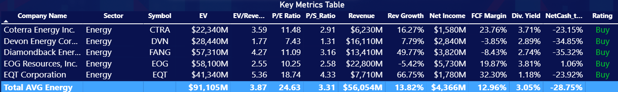

TOP Value
• Diamondback Energy (FANG), is an American independent oil and natural gas company. It has $57.3B enterprise value, trades at an EV / Revenue multiple of 4.27, reflecting a moderate valuation, slightly above industry multiple (3.87). The company has a strong 49.8% revenue growth (13.82% industry AVG), a solid net income of $3.82B, a low P/E (11) compared to 24.63 from the Energy Sector average and an average P/S Ratio (3.16) . Its FCF Margin of –8.4% suggests recent heavy reinvestment or rising costs are pressuring cash generation.
The company maintains a 2.7% dividend yield, offering shareholder returns, though a –35% Net Cash to Market Cap ratio indicates moderate leverage.

Slide 29
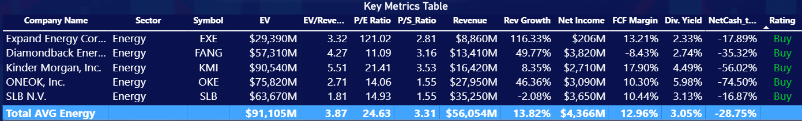
TOP Value
ONEOK, Inc. (OKE), an energy infrastructure company, has an enterprise value of $75.8B and trades at an EV / Revenue multiple of 2.71 and a P/S ratio of 1.55, suggesting a moderate to low valuation relative to industry EV Multiple and P/S Ratio of 3.87 and 3.31 respectively.
The has a very solid revenue growth of 46.4% (13.82% industry average), a healthy profitability with net income of $3.1B and a P/E ratio of 14.1 (10 points lower than 24.63 industry average). Its free cash flow margin of 10.3% indicates good cash generation capacity, supporting a robust dividend yield of 5.98%.
Overall, ONEOK appears to be a financially solid mid-to-high-yield energy play. It’s growing well, efficiently converting profits to cash, and trading at good discount compared to S&P 500 prices and its peers.

Slide 30
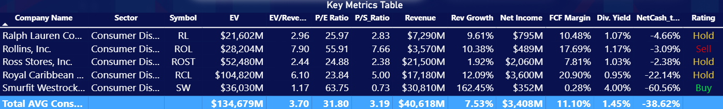
TOP Value
Smurfit Westrock Plc (SW), a global leader in sustainable paper and packaging company valued at $36.0B enterprise value, trades at a modest EV/Revenue multiple of 1.17 and a P/S ratio of 0.73, suggesting the market prices it conservatively relative to its large revenue base of $30.8B.
Despite an exceptional 162% revenue growth, its P/E ratio of 63.8 indicates that earnings remain thin, consistent with a small net income of $352M (approx. 1% of Revenue) and a nearly flat free cash flow margin of 0.28%.
The company offers a 4.0% dividend yield, signaling commitment to shareholder returns even amid low profitability, while a –60.6% Net Cash to Market Cap ratio shows significant leverage.

Slide 31
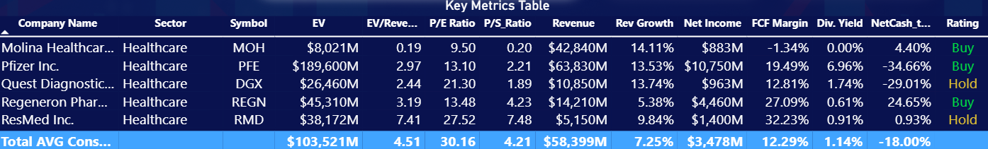
TOP Value
Pfizer Inc. (PFE), a global pharmaceutical and biotechnology corporation, stands out positively within the Healthcare sector. With an enterprise value of $189.6B and an EV/Revenue multiple of 2.97, Pfizer trades at a discount to the sector average of 4.51, suggesting the market values it more conservatively relative to its peers.
Its P/E ratio of 13.1 is also less than half the sector’s 30.2, implying investors see Pfizer as mature and stable rather than high-growth. Despite that, Pfizer shows solid fundamentals — revenue of $63.8B (above $58.4B sector average), 13.5% revenue growth (vs. 7.3%), and a strong free cash flow margin of 19.5%, comfortably outperforming the sector’s 12.3%. The company also offers a 6.96% dividend yield, far exceeding the sector’s 1.14%, making it an appealing choice for income-oriented investors.
The main drawback is leverage, with net cash to market cap at –34.7% compared to the sector’s –18%, indicating higher debt levels. Overall, Pfizer appears undervalued relative to its sector peers, combining strong cash generation and income returns with moderate growth and higher leverage.

Slide 32
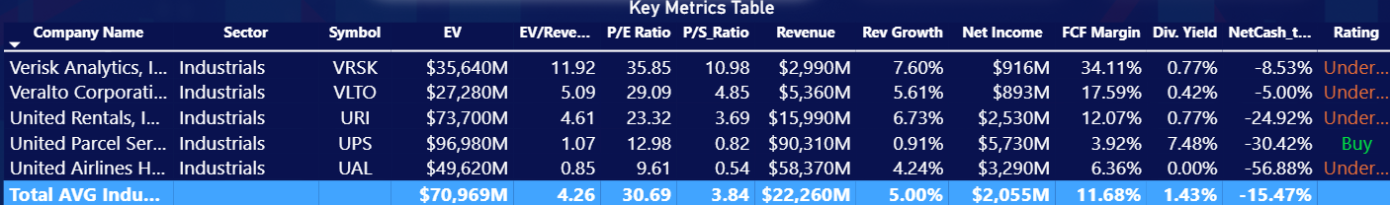
TOP Value
United Parcel Service (UPS), a global leader in package delivery and logistics, trades at a significant discount to the broader Industrials sector, reflecting its profile as a mature, lower-growth logistics leader. With an enterprise value of $97.0B and an EV/Revenue multiple of just 1.07 versus the sector’s 4.26, the market values UPS’s sales far more conservatively. Its P/E ratio of 13.0 is also well below the sector average of 30.7, signaling relatively modest growth expectations. Despite flat revenue growth (0.9%), UPS maintains solid profitability with $5.7B in net income and a 3.9% free cash flow margin, though both lag behind the sector’s higher 11.7% cash efficiency.
The standout metric is UPS’s 7.48% dividend yield, dramatically exceeding the sector’s 1.43%, positioning it as a strong income stock. However, a –30.4% net cash-to-market-cap ratio shows higher leverage than peers.
Overall, UPS appears undervalued relative to the industrial average, offering steady earnings and exceptional dividends but limited growth and lower cash margins compared with the broader sector.

Slide 33
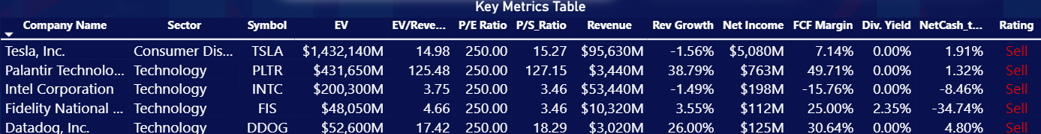





TOP Overvalued
S&P500
These are the TOP 5 Overvalued companies to watch right now, all of them belong to the Technology sector except Tesla, but one can very easily argue Tesla is also a technology company with big ambitions on AI and robotics. The fact that all of these belong to the same sector indicates there might be a bubble brewing.

Slide 34
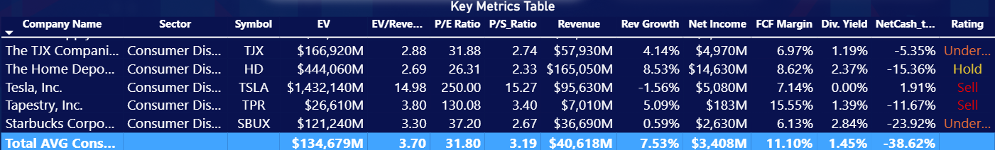
TOP Overvalued
Tesla, Inc. (TSLA), designs and manufactures electric vehicles, renewable energy products, and advanced energy solutions to accelerate the world’s transition to sustainable energy. Trades at extraordinarily high valuation levels relative to the broader Consumer Discretionary sector, reflecting investors expectations for long-term innovation and dominance rather than current fundamentals.
With a massive enterprise value of $1.43 trillion, Tesla’s EV/Revenue multiple of 14.98 and P/S ratio of 15.27 are roughly 4× higher than the sector averages (3.7 and 3.19, respectively), indicating the market is willing to pay a large premium for each dollar of sales. However, this premium contrasts with recent performance — revenue declined by 1.6%, versus sector growth of 7.5%, and its free cash flow margin (7.1%) trails the sector’s 11.1%. The P/E ratio of 250 highlights extreme valuation relative to earnings, as profitability remains modest at $5.1B net income (5.3% of Revenue). Tesla pays no dividend, aligning with its reinvestment-driven model, and holds a relatively healthy net cash position of +1.9%, unlike the sector’s -38.6%, reflecting financial flexibility.
Overall, Tesla is valued as a high-growth, innovation driven outlier, richly priced for its future potential but currently under delivering on growth and cash efficiency compared with its peers.

Slide 35
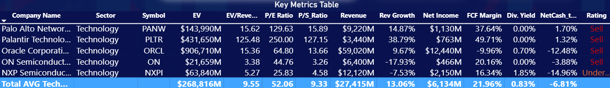
TOP Overvalued
Palantir Technologies Inc. (PLTR) is a data analytics and software company that builds platforms to help organizations integrate, analyze, and make decisions from large, complex datasets.
It shows exceptionally inflated valuation metrics compared to the broader Technology sector, highlighting its status as a high-growth, high-expectation stock. With an enterprise value of $431.7B, Palantir trades at an extraordinary EV/Revenue multiple of 125.5 and P/S ratio of 127.2, far above the sector averages of 9.55 and 9.33, respectively — meaning investors are paying over 100× more per dollar of sales than for a typical tech peer. Despite this, Palantir’s revenue growth of 38.8% and very strong free cash flow margin of 49.7% indicate robust business expansion and operational efficiency. Its P/E ratio of 250 suggests earnings remain small relative to its valuation, and it offers no dividend, consistent with a reinvestment-oriented growth model. With a net cash-to-market-cap of +1.3%, the company maintains a healthy balance sheet, unlike the sector’s average –38.6% leverage.
Overall, Palantir is valued at extreme multiples that far exceed sector norms, supported by impressive growth and cash generation — but its valuation implies very high expectations for future performance, leaving little room for execution risk.

Slide 36
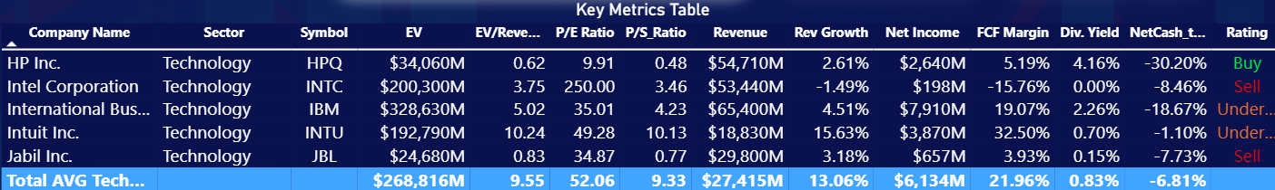
TOP Overvalued
Intel Corporation (INTC), is a global semiconductor company that designs and manufactures microprocessors and advanced computing technologies powering everything from personal computers to data centers and AI systems.
It currently trades near sector-average valuation levels but with weaker fundamentals and profitability, reflecting its transitional phase. With an enterprise value of $200.3B, Intel’s EV/Revenue multiple of 3.75 and P/S ratio of 3.46 are lower than the Technology sector averages (3.7 and 3.19). However, Intel’s revenue declined by 1.5%, contrasting with the sector’s 7.5% growth, and its free cash flow margin of –15.8% signals significant cash burn, likely from heavy capital investments in manufacturing capacity and process modernization. The P/E ratio of 250 reflects minimal earnings ($198M net income) relative to its size, indicating that current profits don’t justify its valuation without improvement. Intel offers no dividend yield and carries low leverage (–8.5% net cash-to-market-cap), healthier than the sector average of –38.6%.
Overall, Intel appears to be fairly valued on sales but heavily underperforming operationally, with investors likely pricing in expectations of a long-term turnaround, which carries big risks.

Slide 37
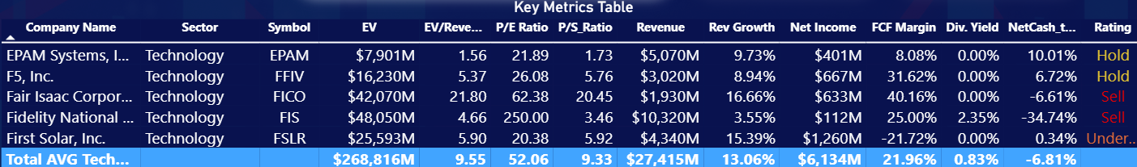
TOP Overvalued
Fidelity National Information Services (FIS) is a global financial technology company that provides software, services, and infrastructure for banks, merchants, and capital markets to enable secure and efficient digital financial transactions.
It trades at a discount to the broader Technology sector on sales multiples but shows mixed performance in growth and profitability. With an enterprise value of $48.1B, the company’s EV/Revenue multiple of 4.66 sits below the sector average of 9.55. However, its revenue growth of 3.6% lags the sector’s 7.5%, indicating more modest expansion. The P/E ratio of 250 underscores limited current earnings ($112M net income) relative to valuation, though the company’s free cash flow margin of 25% stands out as notably strong, showing solid cash generation despite low accounting profits. A 2.35% dividend yield adds income appeal, but leverage levels (–34.7% net cash-to-market-cap) are significantly above sector norms.
Overall, FIS is trading at a discount when it comes to Revenue and Sales, but it’s Net Income and Revenue Growth are significantly below sector averages. Also, it’s current leverage does not offer much security if the company does not drastically improve profitability.

Slide 38
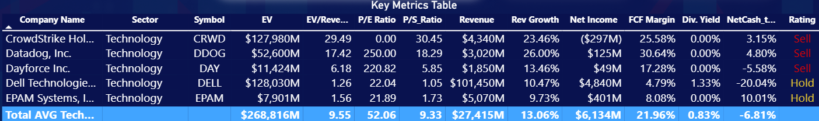
TOP Overvalued
Datadog, Inc. (DDOG) is a cloud-based monitoring and analytics platform that helps organizations observe, secure, and optimize their IT infrastructure, applications, and logs in real time.
It commands a premium valuation within the Technology sector, reflecting investor confidence in its strong growth and profitability profile. With an enterprise value of $52.6B, Datadog trades at a lofty EV/Revenue multiple of 17.4 and P/S ratio of 18.3, double than the sector averages of 9.55 and 9.33, signaling that the market is pricing in substantial future expansion. This optimism is supported by impressive revenue growth of 26%, well above the sector’s 7.5%, and a robust free cash flow margin of 30.6%, indicating excellent cash efficiency for a high-growth software firm. However, its net income of $125M results in a high P/E ratio of 250, this is typical of growth-oriented tech companies investing heavily to scale. Datadog pays no dividend, preferring to reinvest profits, and holds a net cash position of +4.8%, suggesting a strong balance sheet and financial flexibility.
Overall, Datadog is a high-growth, cash-generative company trading at extremely elevated multiples, hard to justify unless if it can sustain its rapid expansion and operational discipline for many years to come.

Slide 39

Thank you for your attention!
Click the arrow to revisit Insights & Recommendations

